Slide 1
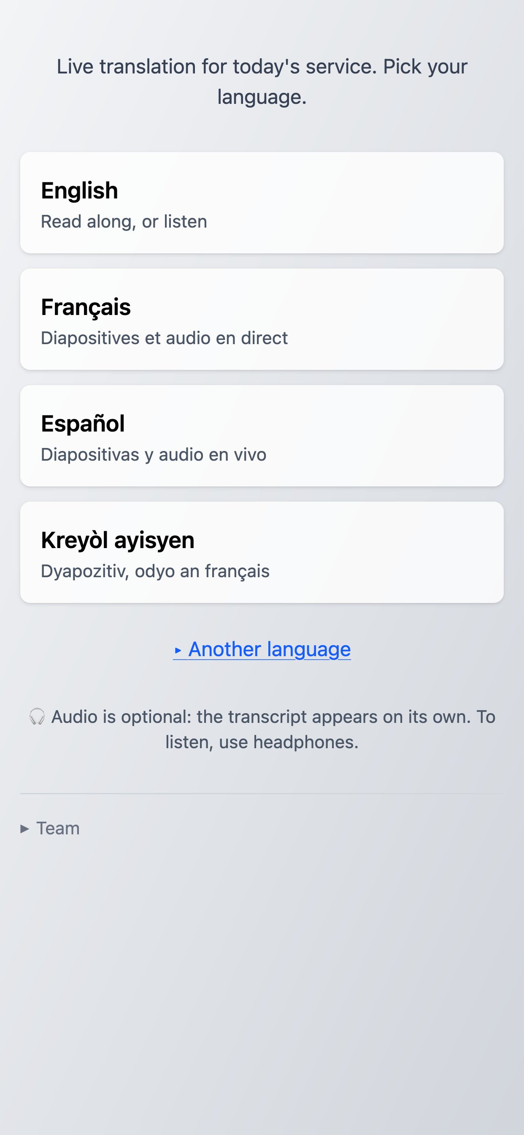
From Every Language: Using AI for Live Translation in Worship
Ken Arnold
Calvin University
New City Fellowship PCA

Slide 2
Does your church use translation (AI or human) in worship?

Slide 3
⁹ After this I looked, and there before me was a great multitude that no one could count, from every nation, tribe, people and language, standing before the throne and before the Lamb. They were wearing white robes and were holding palm branches in their hands. ¹⁰ And they cried out in a loud voice:
“Salvation belongs to our God,
who sits on the throne,
and to the Lamb.”
[NIV]
⁹ Después de esto miré y apareció una multitud tomada de todas las naciones, tribus, pueblos y lenguas; era tan grande que nadie podía contarla. Estaban de pie delante del trono y del Cordero, vestidos de ropas blancas y con ramas de palma en la mano. ¹⁰ Proclamaban a gran voz:
«¡La salvación viene de nuestro Dios
que está sentado en el trono
y del Cordero!».
[NVI]
⁹ Après cela, je regardai et je vis une foule immense que personne ne pouvait compter. C’étaient des hommes de toute nation, de toute tribu, de tout peuple et de toute langue. Ils se tenaient debout devant le trône et devant l'Agneau, habillés de robes blanches, des feuilles de palmiers à la main, ¹⁰ et ils criaient d'une voix forte: «Le salut est à notre Dieu qui est assis sur le trône et à l'Agneau.»
[Segond 21]
⁹ Apre sa, mwen gade ankò, mwen wè yon gwo foul moun. Pesonn pa t' kapab konte kantite ki te gen ladan li. Se te moun tout lòt nasyon, tout kalite ras, pèp tout peyi ak tout lang. Yo te kanpe la devan fòtèy la ak devan ti Mouton an. Yo te gen rad tou blan sou yo, yo te gen fèy palmis nan men yo.
¹⁰ Yo t'ap rele byen fò, yo t'ap di: Se Bondye nou an ki chita sou fòtèy la. Se li menm ansanm ak ti Mouton an ki vin delivre nou. [BSA]

Slide 4
Jesus is worthy of praises
from every language.
But how will they hear?

Slide 5
Now there were staying in Jerusalem God-fearing Jews from every nation under heaven. ⁶ When they heard this sound, a crowd came together in bewilderment, because each one heard their own language being spoken. ⁷ Utterly amazed, they asked: “Aren’t all these who are speaking Galileans? ⁸ Then how is it that each of us hears them in our native language? ⁹ Parthians, Medes and Elamites; residents of Mesopotamia, Judea and Cappadocia, Pontus and Asia, ¹⁰ Phrygia and Pamphylia, Egypt and the parts of Libya near Cyrene; visitors from Rome ¹¹ (both Jews and converts to Judaism); Cretans and Arabs—we hear them declaring the wonders of God in our own tongues!” ¹² Amazed and perplexed, they asked one another, “What does this mean?”

Slide 6
Linguistically Hospitable Congregations
At least three ways the Gospel transcends language barriers:
Native monolingual churches among all linguistic groups
Intentionally multilingual congregations (intensive commitment, few languages)
Linguistically hospitable congregations.
  Any visitor, with any linguistic abilities, can hear (or read) the wonders of God in their own language.

Slide 7
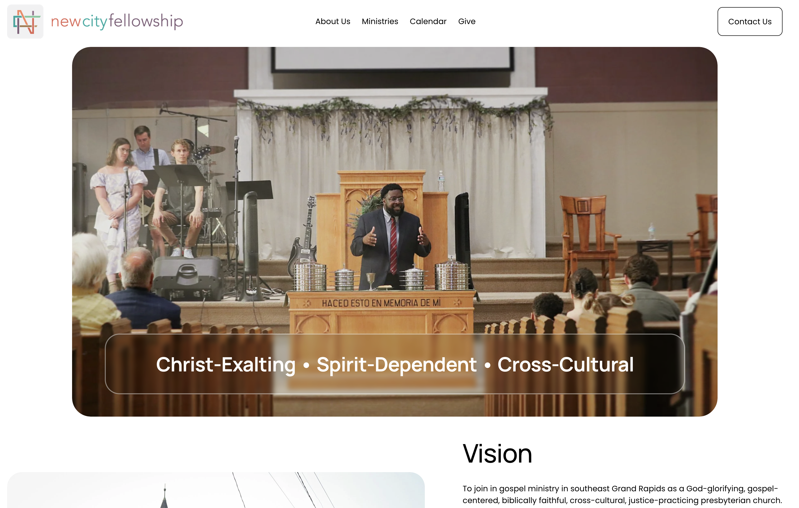

Slide 8
My Church Context: New City Fellowship GR
SE Grand Rapids, surrounded by White, Black, and Latino neighborhoods
Some past attempts at multilingual welcome (Spanish)
Haitian extended family and friends…
I like building things to serve God’s people. Can I serve these people?
Notes:
Hey, I thought I could use my Spanish skills… but move from “I can personally speak Spanish” to “I can help anyone with any language feel welcomed”

Slide 9
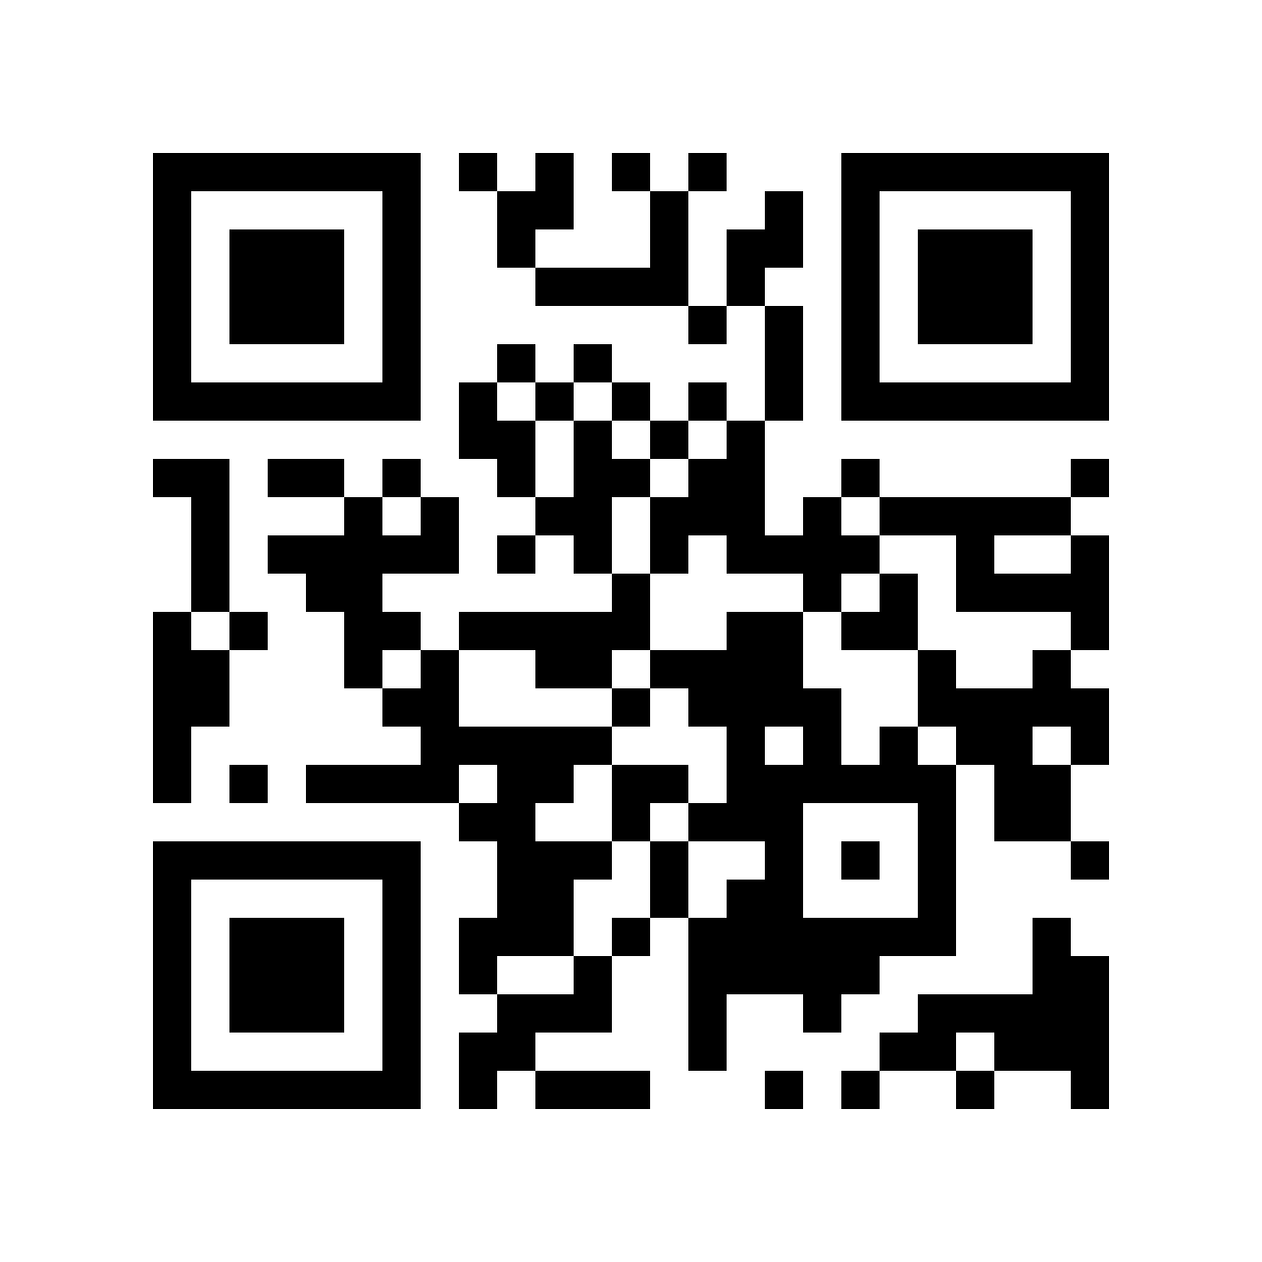
From Every Language system

Slide 10
How It Fits Together
IN THE SOUND BOOTH
ONLINE
IN THE PEWS
Presentation computer
Proclaim, as usual. A small program reads the slides; the operator changes nothing about how they work.
Our server
Serves the web page
Keeps one shared record per service, live to every phone
Decides what needs translating and remembers approved work
Anyone’s phone
A link or QR code. No app, no account.
slide text
translations
Sound board + a Mac
The pulpit mic goes to a menu-bar app that starts and stops on a weekly schedule. Any laptop browser can do the same job.
Slides in my language
Sermon notes
live audio
Listen + read along
Note-taker’s laptop (optional)
Someone types the sermon outline as it is preached.
Paid AI services
Gemini: text and speech translation
ElevenLabs: read-aloud
Buttons shown in French, Creole, Spanish or English
typed notes
Everything meets at one server. The church supplies the booth devices and a link; attendees supply their own phones.

Slide 11
A short history
[Fall 2024] translating slides by hand (shown on aux screen)
[Spring 2025] initial note-taking app
[Summer 2025] join slides + notes into a single app (still manual)
[Fall 2025] new visitors less comfortable reading, so add speech
[Spring 2026] connect directly to Proclaim, bilingual view
[Summer 2026] add live speech translation, automate slide translation

Slide 12
Slide Translations
ONE SLIDE AT A TIME
slide 4 of 7
“and He shall reign for ever and ever”
CANNOT SEE
the other six slides, or who “He” is
that this is Scripture, already published
what we chose last week · who checked it
Translator
Screen
THE SLIDE AGENT
The whole song or reading
every slide, plus its title
Reviewer
reads the draft and the agent’s notes; replies
Library
approved text, kept for next week
The setting
worship; read along, not sung
Agent
drafts every language at once
Published Bibles
looks up the verse, quotes it
Screens
approved text if any, else the draft
“sounds too formal…”
Past approved translations
for consistent wording
reused the next time this song is sung
Runs during the week on the whole service order. A slide added Sunday morning gets the same treatment when it first appears.
Notes:
Why not just Google Translate?
For understanding, not singing

Slide 13
Why not just Google Translate?
Look up authoritative Bible translations (don’t re-translate)
Resolve ambiguity (e.g., pronouns) from larger context
Use native Bible wordings when a song references them
Library of approved translations
Our Bible versions (from helloao.org API, chosen for licensing convenience)
Hatian Creole: Bib Sen An
French: néo-Crampon Libre
Spanish: Reina Valera 1909
Notes:
…and creeds/confessions/catechisms (TODO)

Slide 14
Song Translation
Initial goal: singable translations, careful review
Found human translations when possible
But nobody was actually singing
And sometimes the human translation took liberties (or didn’t have all verses, or …)
New goal: sing the English text… with understanding.
  Bonus: fewer copyright concerns
Notes:
But I did use the careful translation workflow to help me make an English translation of a French song.

Slide 15
Live Voice Translation
French interpreter
always on: keeps the record
Phone
plays translated voice
shows scrolling text; works with sound off
Preacher
pulpit mic
Sound board
+ Mac app
Audio room
online, like a conference call
Spanish interpreter
starts when someone asks
hears
voice + text
Korean interpreter
not running: nobody asked
One interpreter per language actually in use. One is always on while the preacher is live, so there is a written record even if nobody listened.
Each interpreter is an AI model that translates speech directly into speech. It is never shown a script.

Slide 16
Gaps between first draft and robust system
AI makes first-draft code easy
But still lots of engineering to do!
Many moving parts, so links between parts often failed.
Has been running reliably without me since mid-summer
  Except a failure last week…
Notes:
The failures: live translation cut-outs when listener joins first, slide data going to the wrong day's document
- The operational issues: automating audio feeding, automating updates, visibility of system status

Slide 17
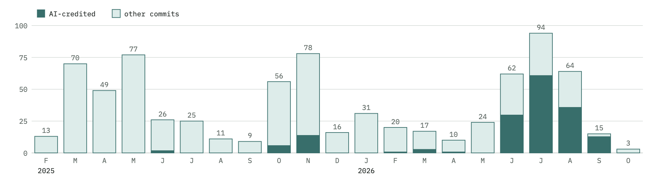
A journey, not a product

Slide 18
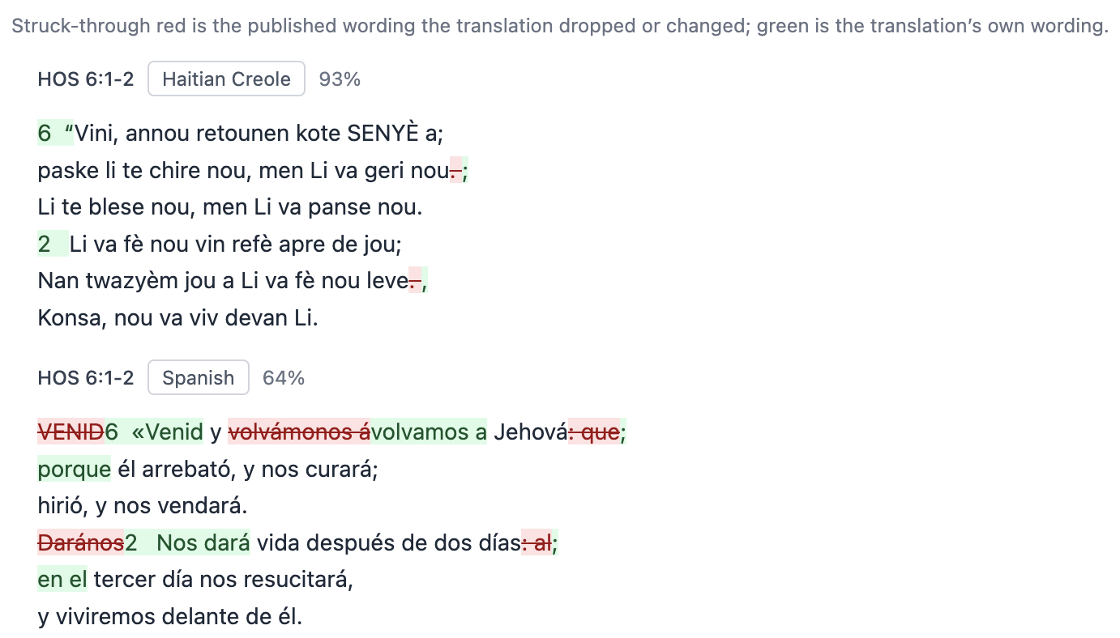
Accountability and Faithfulness

Slide 19
Accountability and Faithfulness
What if the translation…
Says something heretical?
Invents Scripture text?
Omits a point that it judges to be offensive?
Whose voice is the AI speaking as—or writing slides as?

Slide 20
Culturally Appropriate Translations
Exact equivalence in translation is impossible
Bible translations vary: NASB vs NLT
Voice-to-voice translation services don’t let us control trade-offs

Slide 21
Can we use entirely open models?
Could reduce costs and dependence on data centers
But needs more engineering, evaluation…

Slide 22
More kinds of accessibility?
Cognitive differences?
Catching up for parents who stepped out to change a diaper?
Language learning help?

Slide 23
Limitations
It’s not every language.
Translation choices not always culturally appropriate.
Accuracy and accountability.
CS senior project students now joining the team.

Slide 24
Want to try this in your congregation?
So far only deployed at my church, so first other site will be a learning curve
Easiest start: manually typing notes
Slides: easy if Proclaim; other software needs work.
Voice: needs clean audio feed to a computer, and
reliable Internet
https://kenarnold.org/wisdom2026/

